Slide 1
Rendezvous
Movie Meetup.

Slide 2
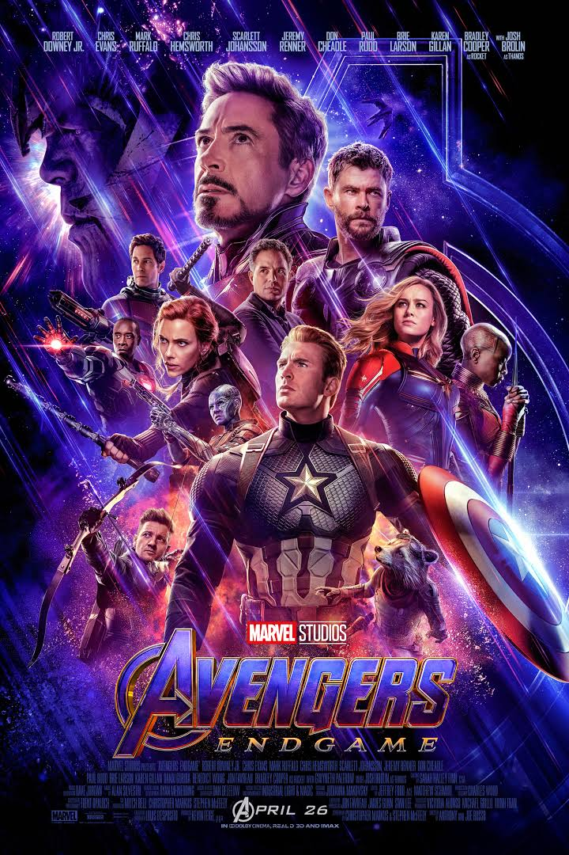
Organising a movie with old friends.
Planning for Avengers End Game
Planning a movie in next month
Meeting a group of 4 people (excluding organiser)
All based in Central London (Piccadilly Circus Exit Gate 6 (tube))

Slide 3
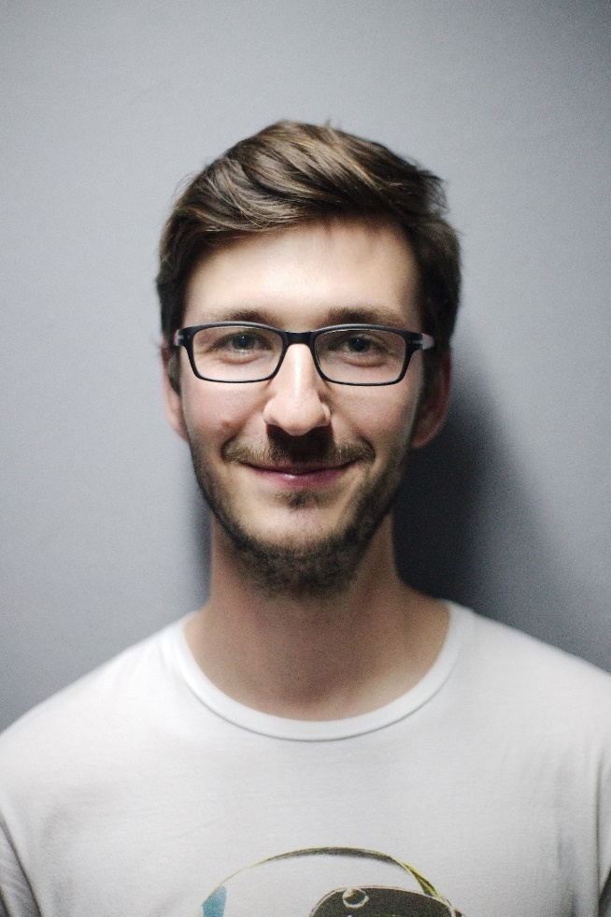
Persona
Mett Grayson
Age : 24
Occupation : UX Designer
Location :Guilford

Slide 4
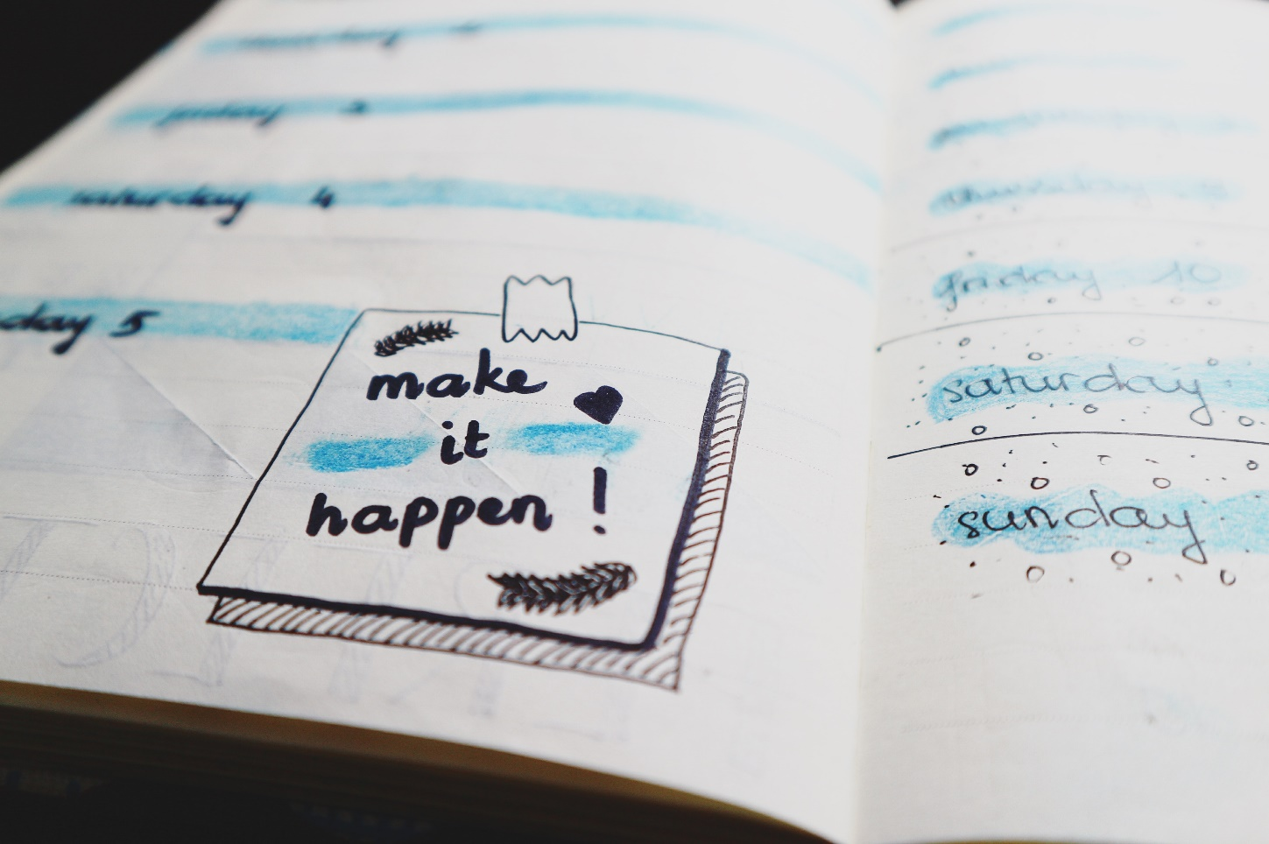
Rendezvous Parameters
Meetup Time : 18:45 PM
Meetup Date : 24 September 2019
Meetup Location : Trafalgar Square
Meetup Movie : Avengers End Game
Meetup Lunch : Leicester Square Kitchen
Meetup Duration : 8 hrs (max)
Meetup Consent Count : Min (3 or dispose of plan)
Mode of Transport : As per convenience
Food Preference : Thai, Indian, Mexican

Slide 5
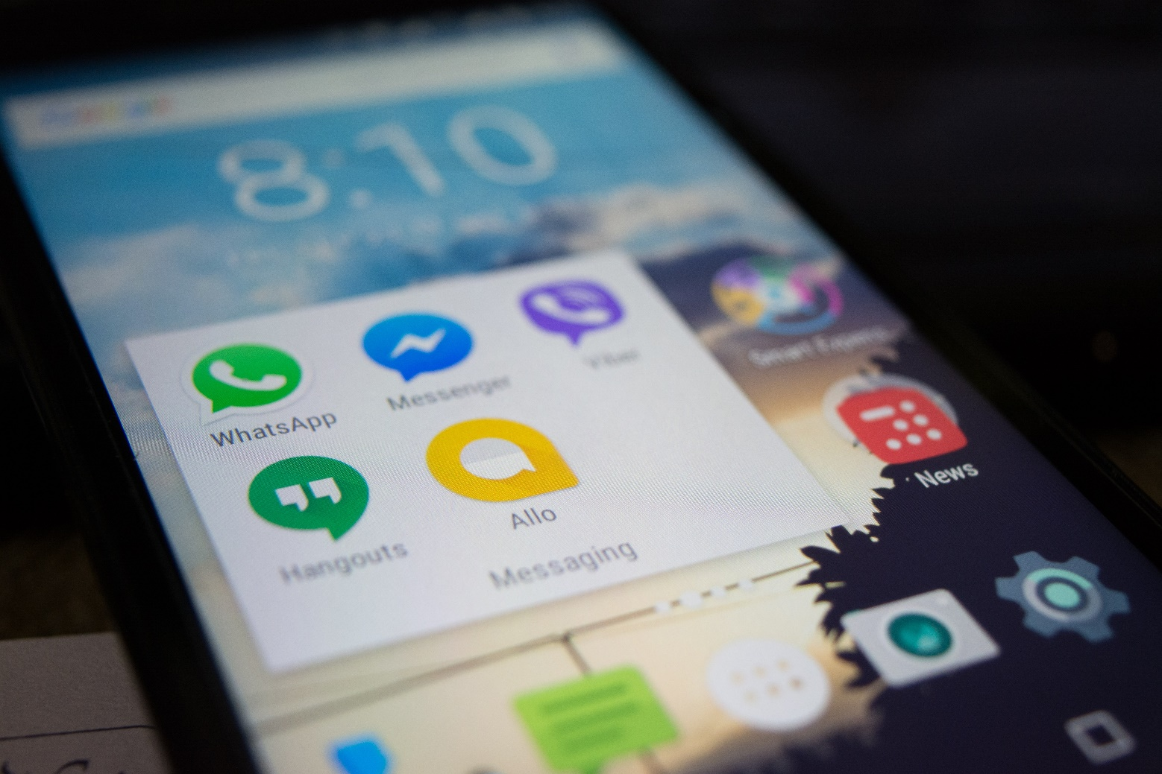
Rendezvous Communication
Individual request to join a group
Create a WhatsApp Group
Polling for dinning choice (I.G Story)
Alternative for movies
Book movies as per conclusion
Send tickets to attendees
Send landmark for location
Send reminders before a day.
Location sharing for perfect rendezvous

Slide 6
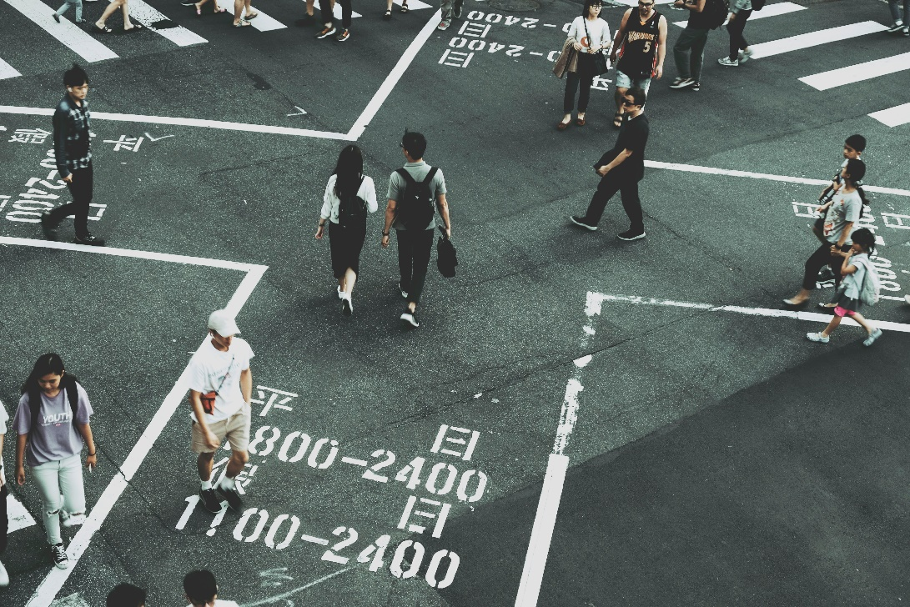
Rendezvous Alternatives
Preferred Movie Genre
Vote Genre
Suggestion on upcoming movies
Suggestions on restaurants to dine
Suggestions for alternate cinema

Slide 7
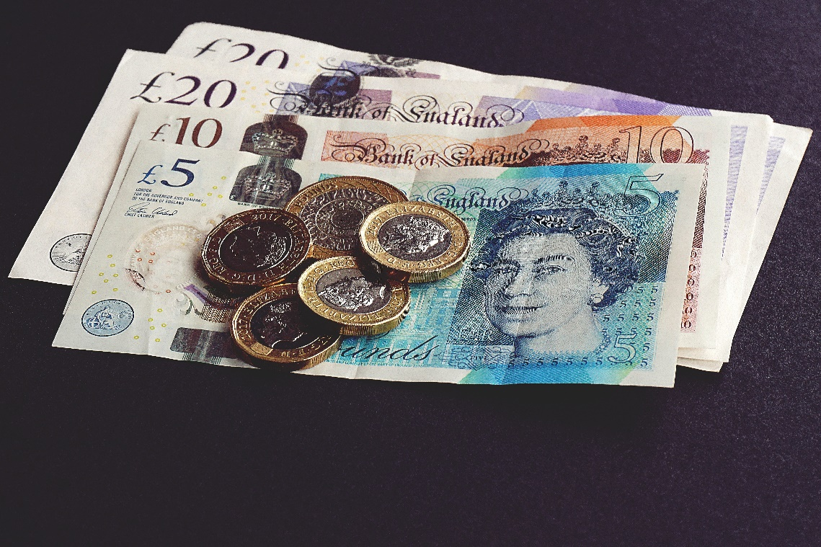
Rendezvous Valuation
Total Costing (movie) : £60
Total Costing (dinning) : £ 150
Individual Costing (movie) : £60
Individual Costing (dinning) : £ 150

Slide 8
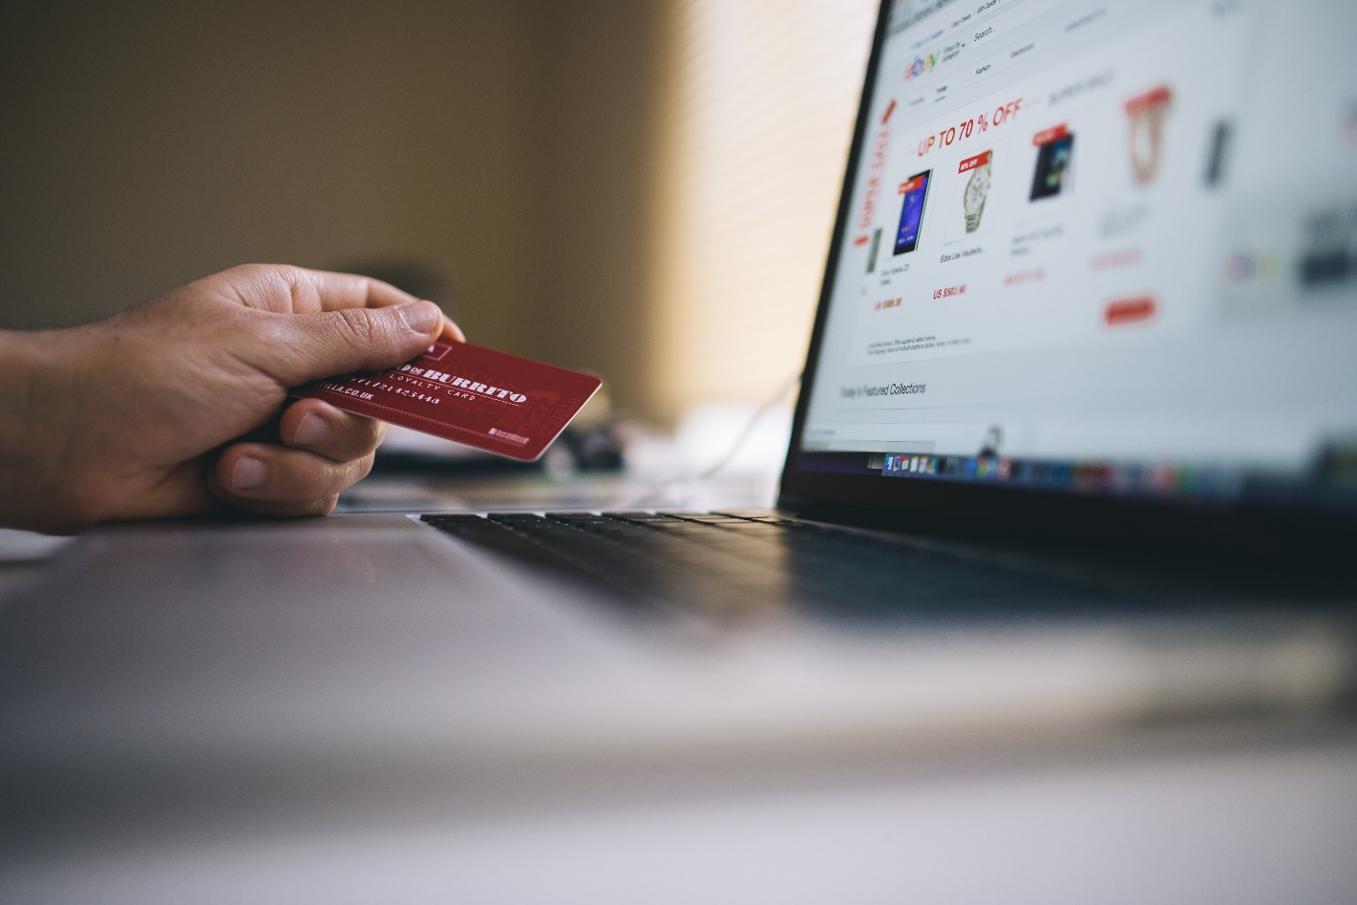
Mode of Payment
PayPal
Card Payment
Split the bill with organiser

